Slide 1
Informatics in Primary Education: Approaches, Current Issues and Lessons Learnt The English experience
Prof Miles Berry
22 August 2022
WCCE 2022

Slide 2
Curriculum Coherence
The term ‘coherence’ is a highly precise technical term: a national curriculum should have content arranged in an order which is securely based in evidence associated with age-related progression, and all elements of the system (content, assessment, pedagogy, teacher training, teaching materials, incentives and drivers etc) should all line up and act in a concerted way to deliver public goods
The term ‘coherence’ is a highly precise technical term: a national curriculum should have content arranged in an order which is securely based in evidence associated with age-related progression, and all elements of the system (content, assessment, pedagogy, teacher training, teaching materials, incentives and drivers etc) should all line up and act in a concerted way to deliver public goods
Oates, 2010
Notes:
The term ‘coherence’ is a highly precise technical term: a national curriculum should have content arranged in an order which is securely based in evidence associated with age-related progression, and all elements of the system (content, assessment, pedagogy, teacher training, teaching materials, incentives and drivers etc) should all line up and act in a concerted way to deliver public goods

Slide 4
Patchy and fragile
Computing education across the UK is patchy and fragile. Its future development and sustainability depend on swift and coordinated action by governments, industry, and non-profit organisations. Neglecting the opportunities to act would risk damaging both the education of future generations and our economic prosperity as a nation.
Royal Society, 2017
Notes:
Computing education across the UK is patchy and fragile. Its future development and sustainability depend on swift and coordinated action by governments, industry, and non-profit organisations. Neglecting the opportunities to act would risk damaging both the education of future generations and our economic prosperity as a nation.

Slide 5
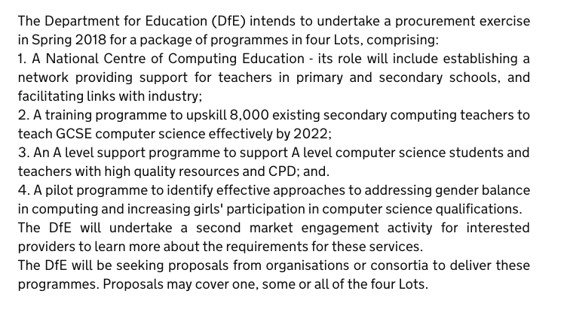
National Centre

Slide 6
Content

Slide 7
The computing curriculum
“We have replaced the old information and communications technology curriculum with a new computing curriculum, with help from Google, Facebook and some of Britain’s most brilliant computer scientists.”
Gove, 2013
Notes:
“We have replaced the old information and communications technology curriculum with a new computing curriculum, with help from Google, Facebook and some of Britain’s most brilliant computer scientists.”

Slide 8
CS, IT, DL
Foundations
Applications
Implications

Slide 9
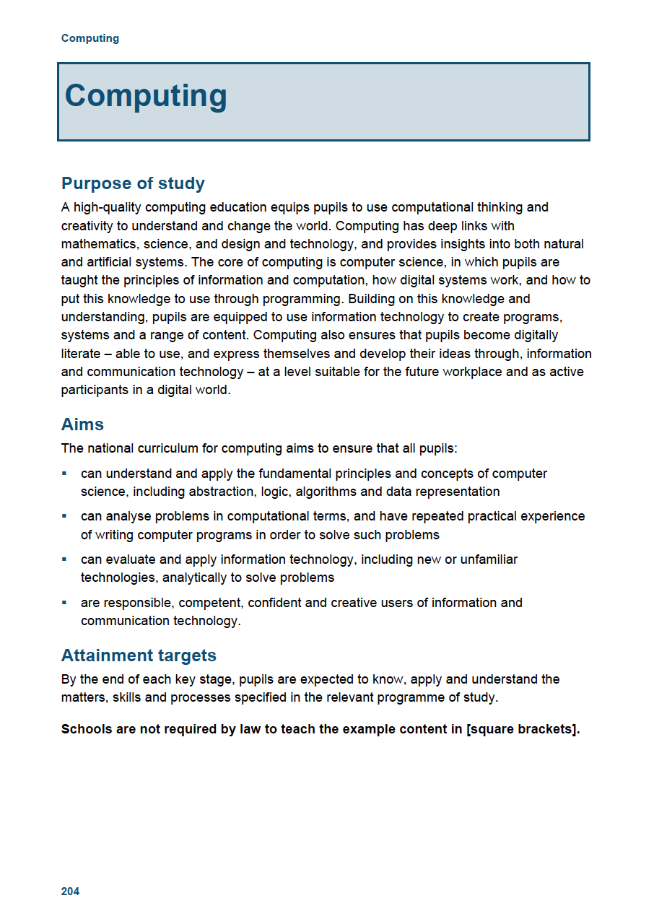
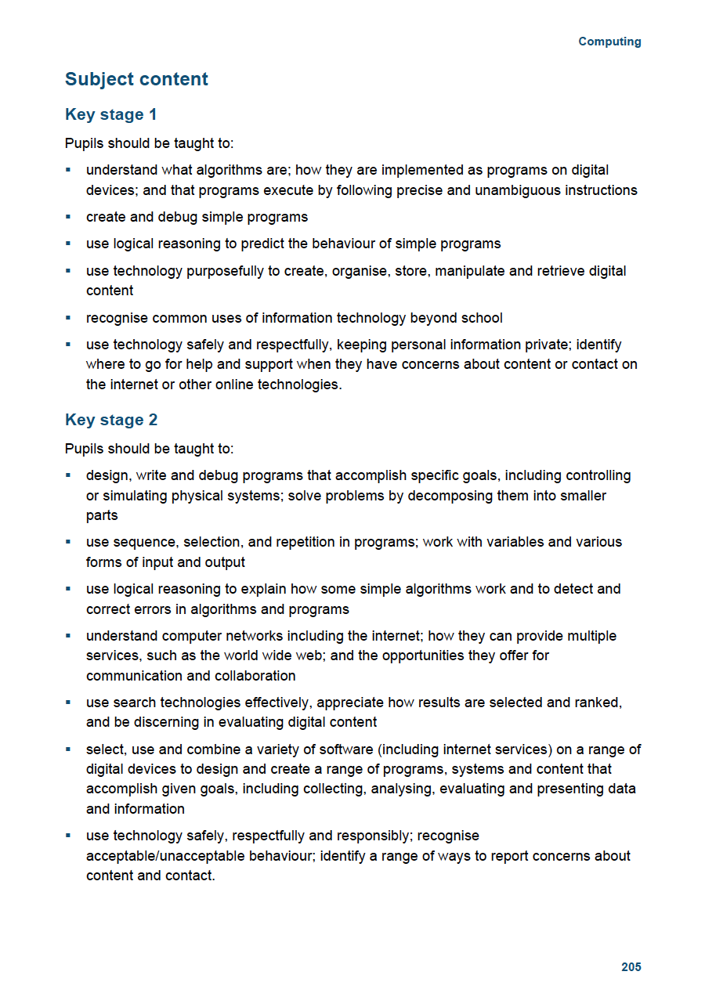
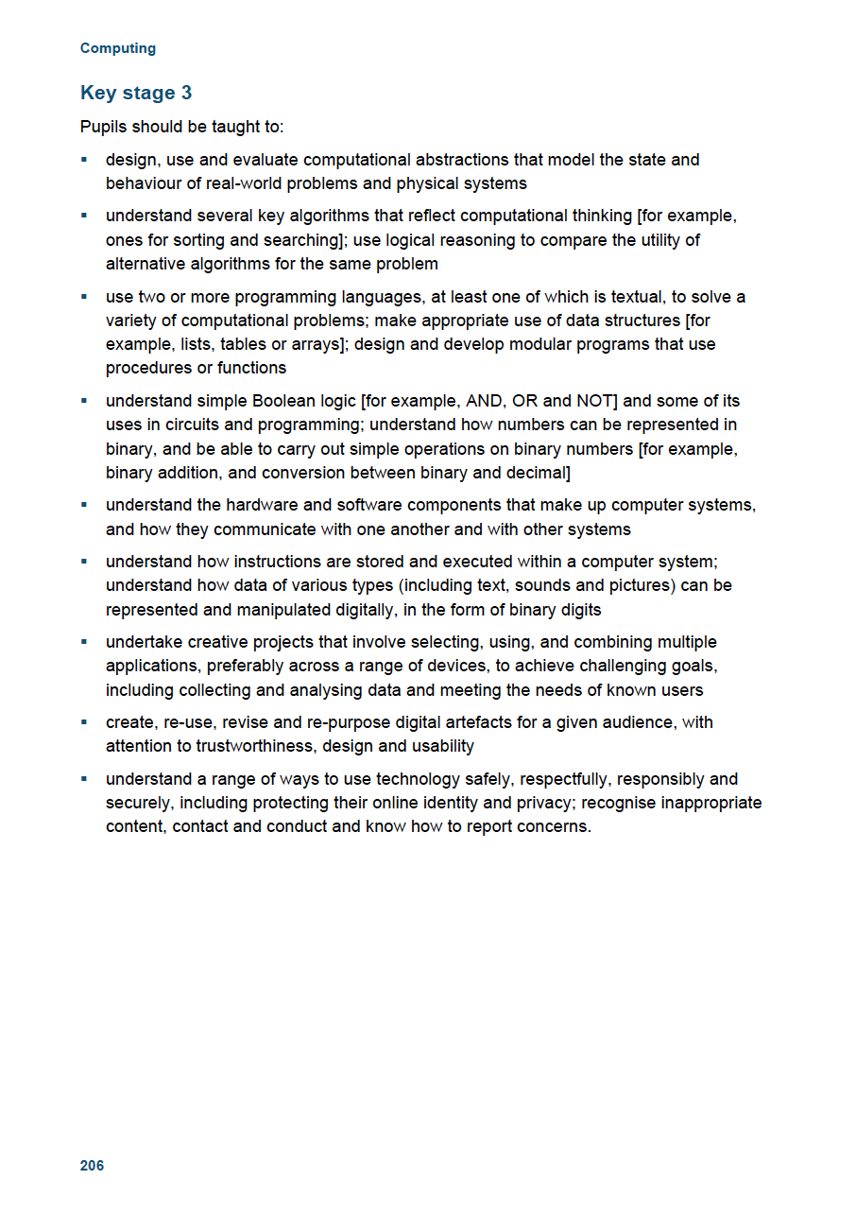
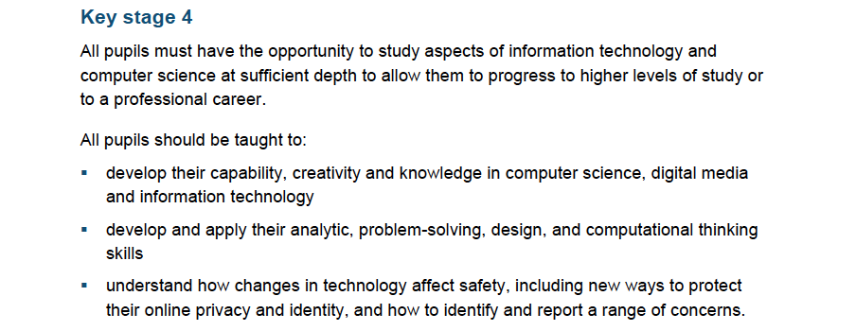
From 5 to 16
DfE, 2013

Slide 10
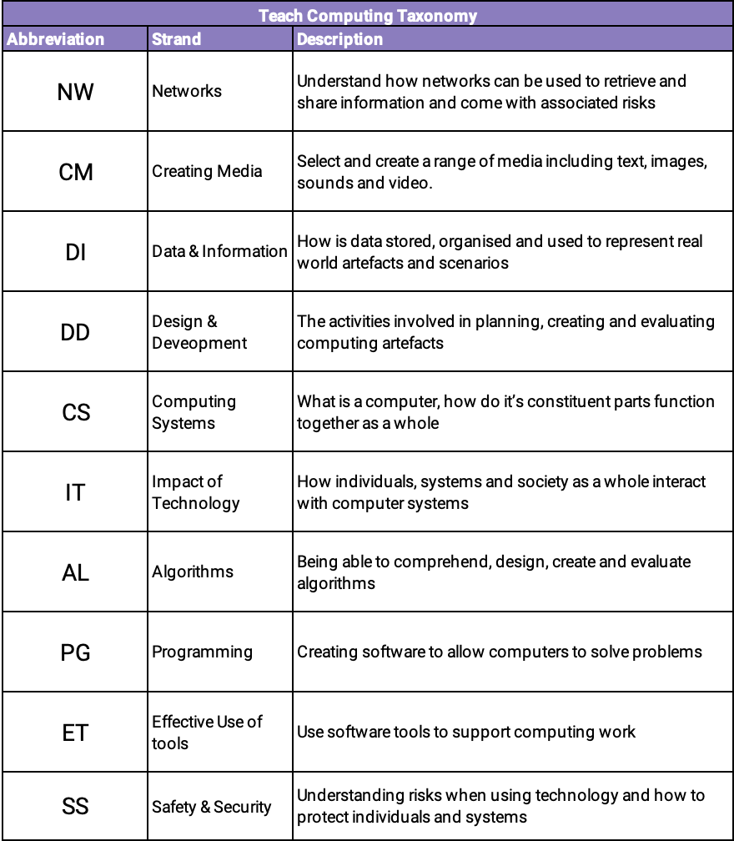

Slide 11
Assessment

Slide 12
Attainment target
By the end of each key stage, pupils are expected to know, apply and understand the matters, skills and processes specified in the relevant programme of study.
DfE, 2013
Notes:
By the end of each key stage, pupils are expected to know, apply and understand the matters, skills and processes specified in the relevant programme of study.

Slide 13
Test questions
The Commission recommends the establishment of a national item bank of assessment questions to be used both for formative assessment in the classroom, to help teachers evaluate understanding of a topic or concept, and for summative assessment, by enabling teachers to create bespoke tests for assessment at the end of a topic or teaching period.
McIntosh et al 2015
Notes:
The Commission recommends the establishment of a national item bank of assessment questions to be used both for formative assessment in the classroom, to help teachers evaluate understanding of a topic or concept, and for summative assessment, by enabling teachers to create bespoke tests for assessment at the end of a topic or teaching period.

Slide 14
Project Quantum - 13,387 questions
free
formative
online
automatically marked
to support teaching
guiding content
measuring progress
identifying misconceptions
qv Oates et al 2015

Slide 15
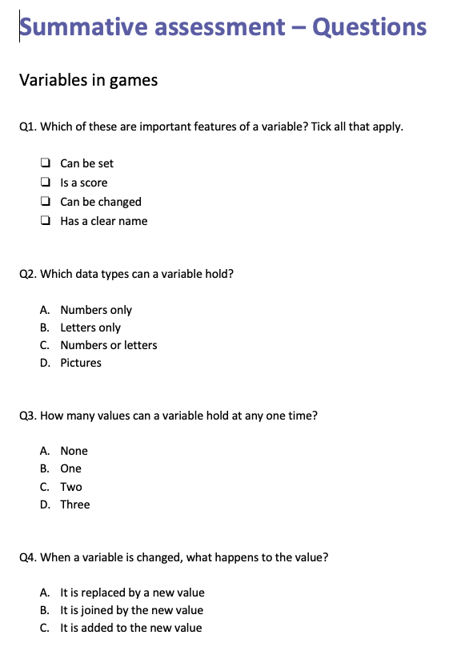
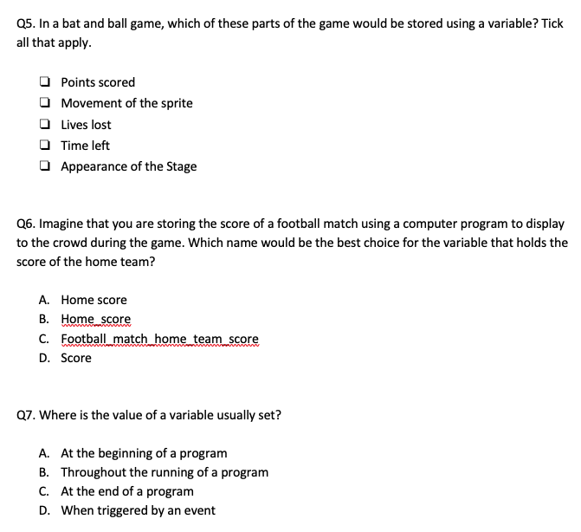

Slide 16
Pedagogy

Slide 17
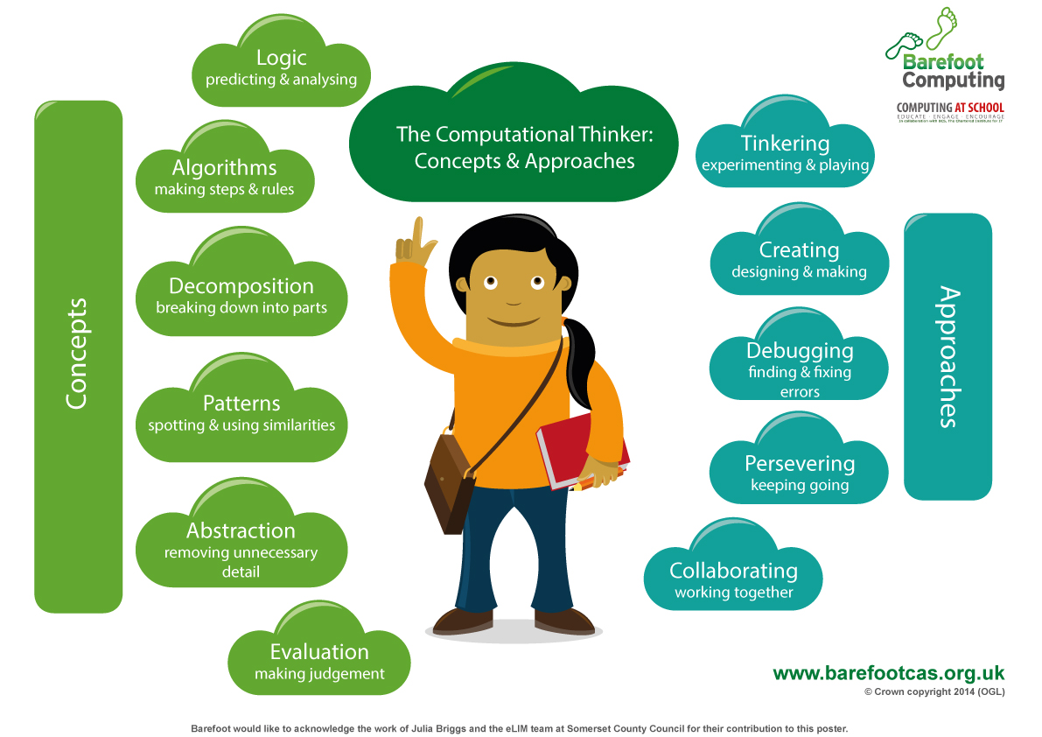
Barefoot, 2014

Slide 18
Sentence, 2017

Slide 19
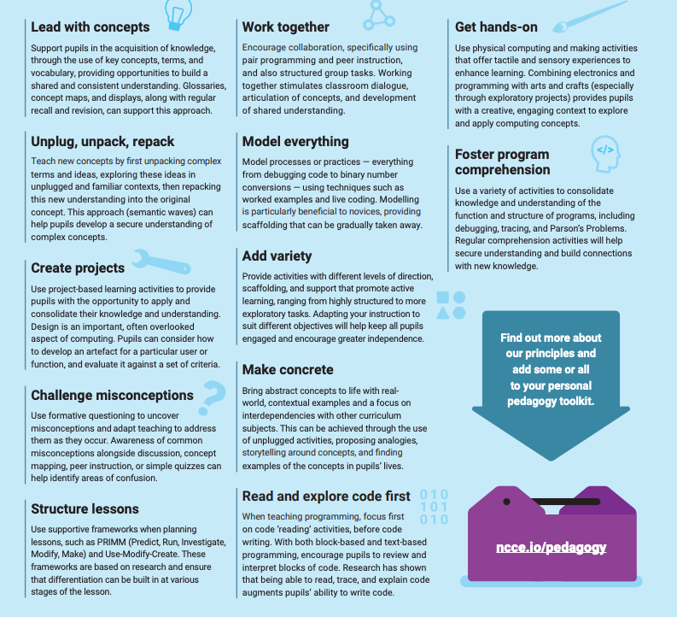
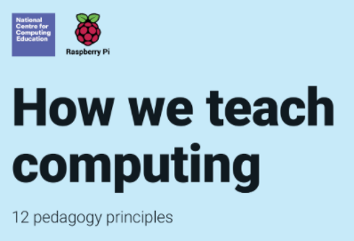

Slide 20
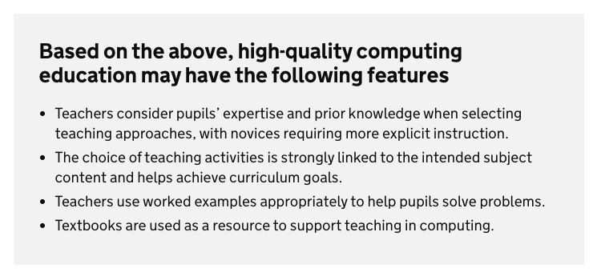

Slide 21
Teacher training

Slide 22
Outstanding computing?
Pedagogy
Outstanding teaching of computing
CS knowledge
CS knowledge
+
=
ICT skills

Slide 23
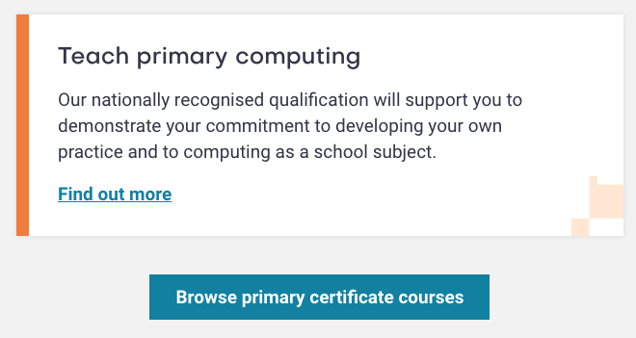
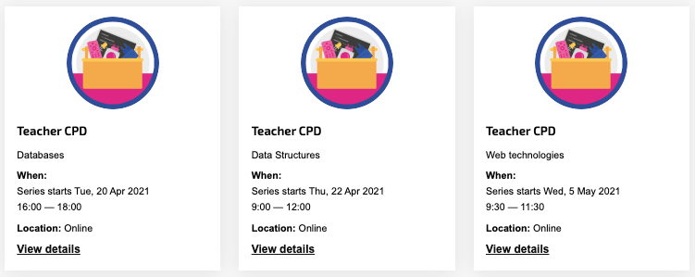
Training, support and accreditation

Slide 24
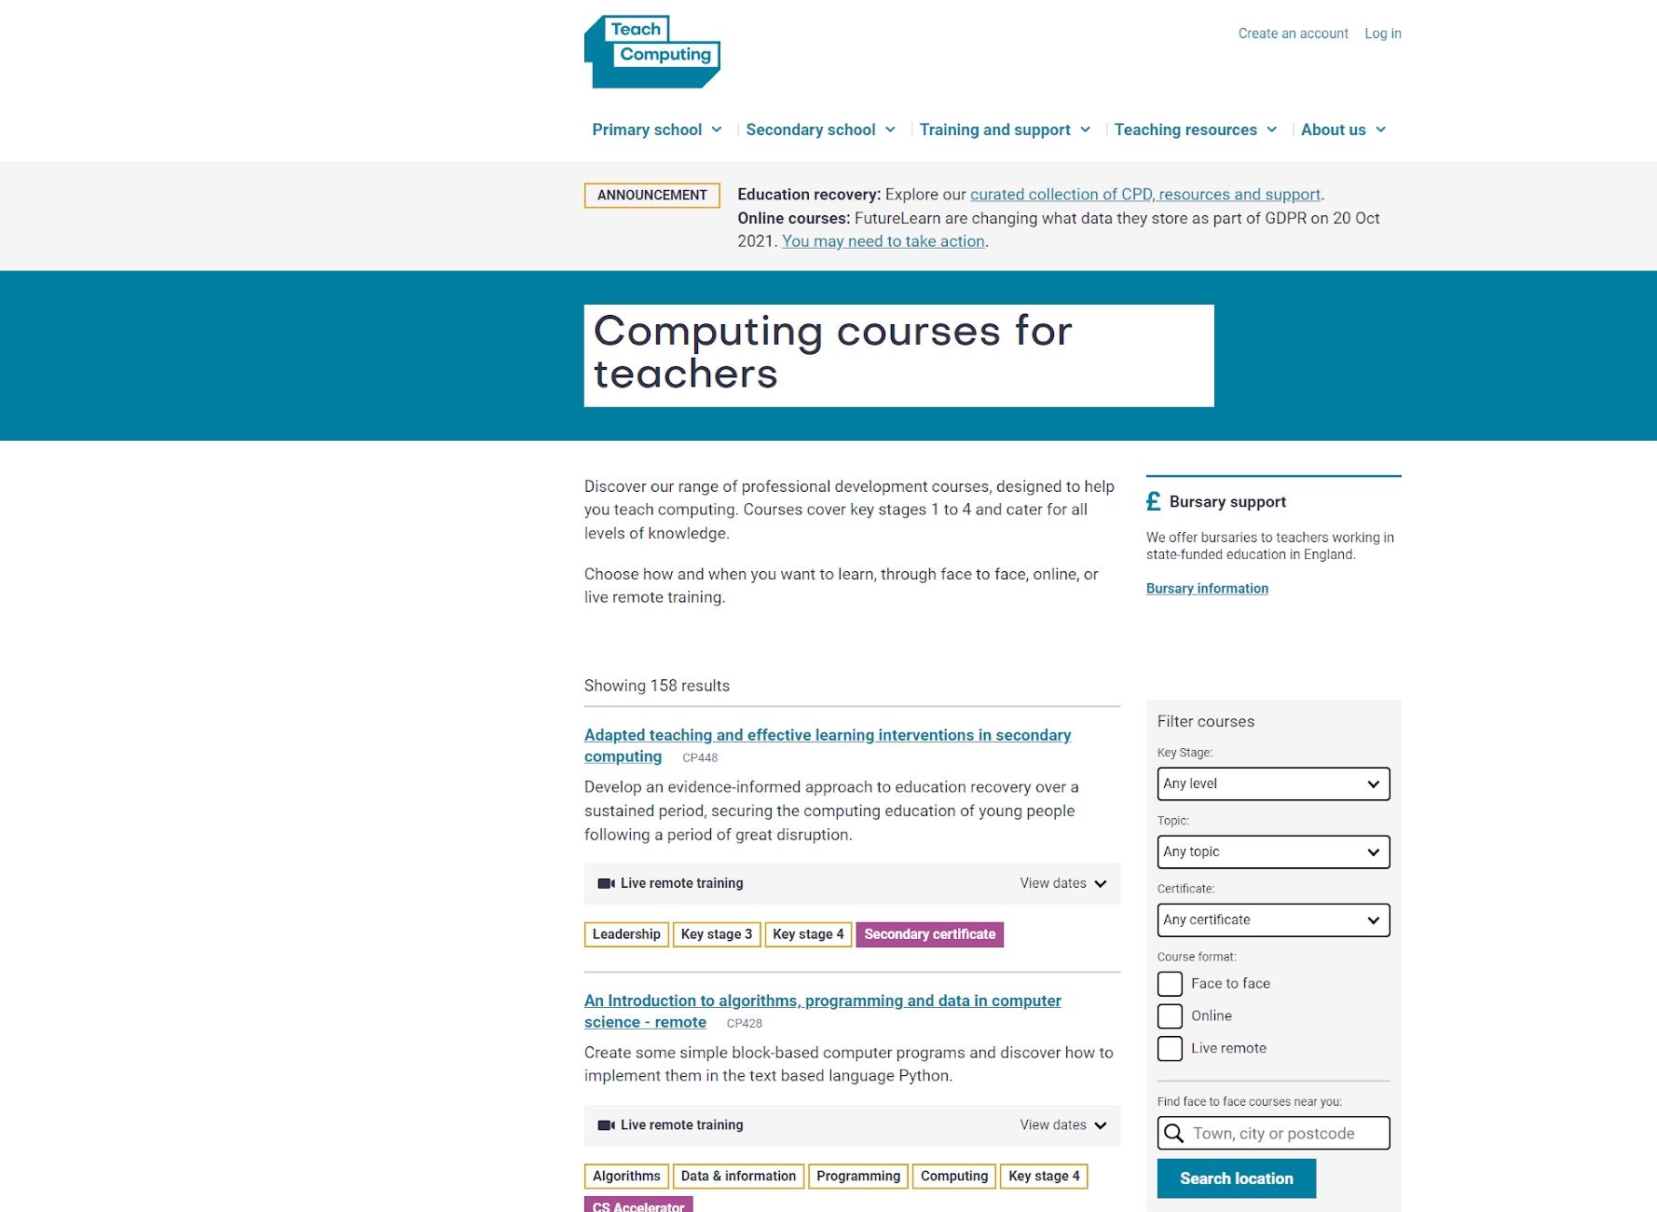
CPD
More than 4000 F2F/remote (synchronous) courses delivered.
Over 17 000 participants in online CPD.

Slide 25
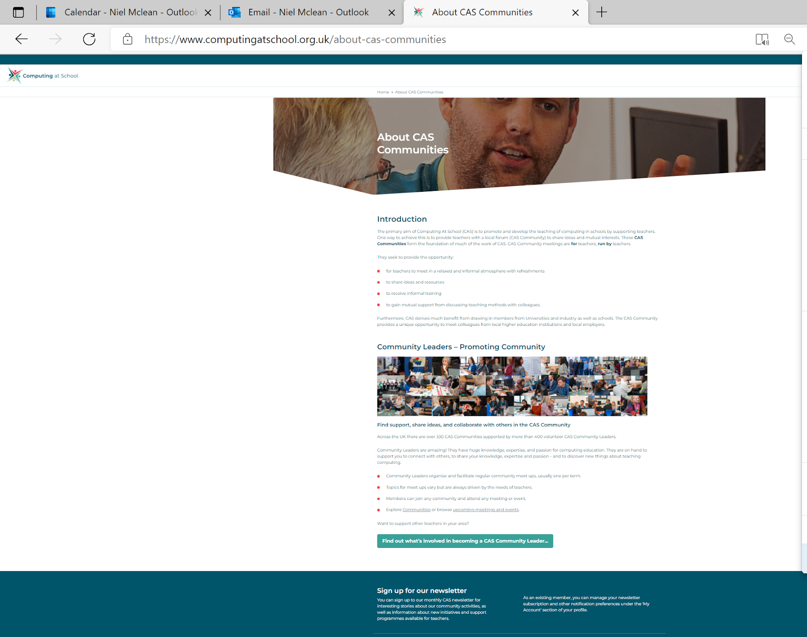
Communities of Practice
Over 330 CAS Communities supported by more than 400 volunteer CAS Community Leaders.
Supported 26 000 activities.
36 coaches have now completed their training through the CAS Leadership Coaching Academy, with 112 teachers to date registering their interest in receiving coaching.

Slide 26
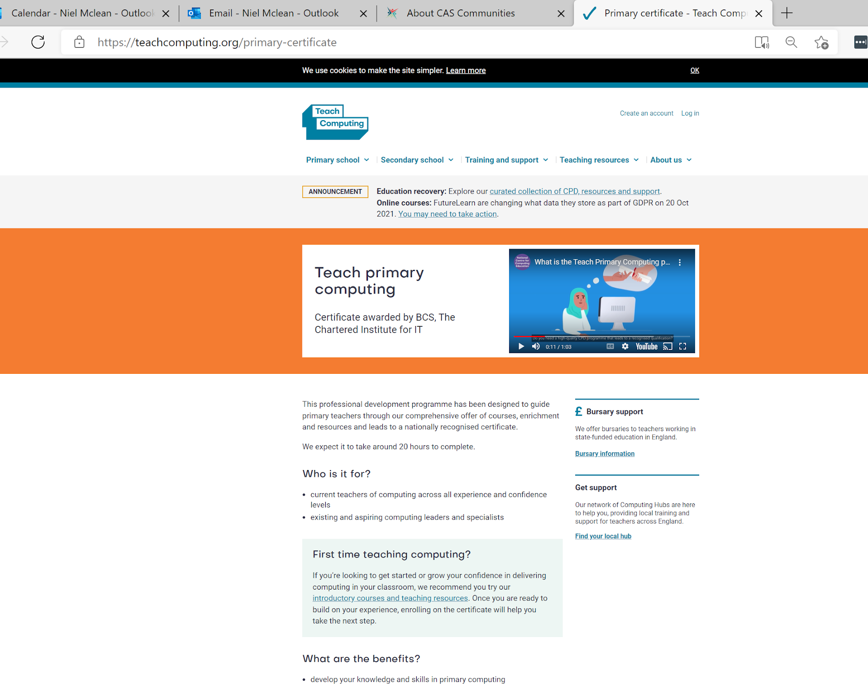
Certification
Over 11 000 teachers enrolled on the NCCE Primary Certificate.

Slide 27
Teaching materials

Slide 29
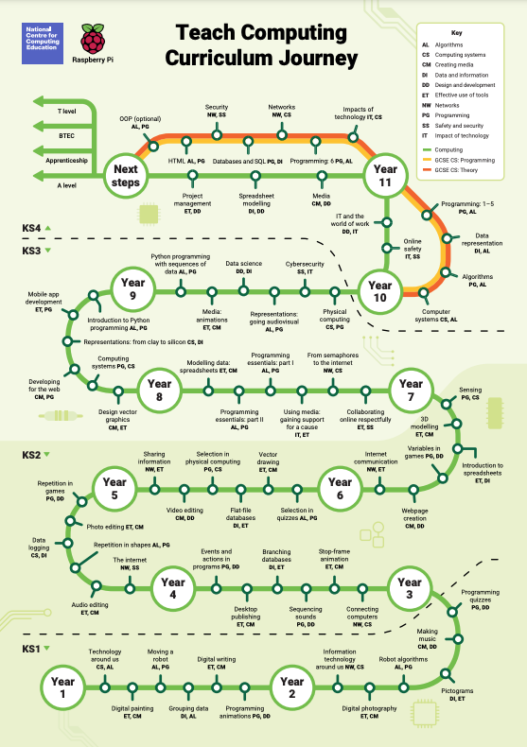

Slide 30
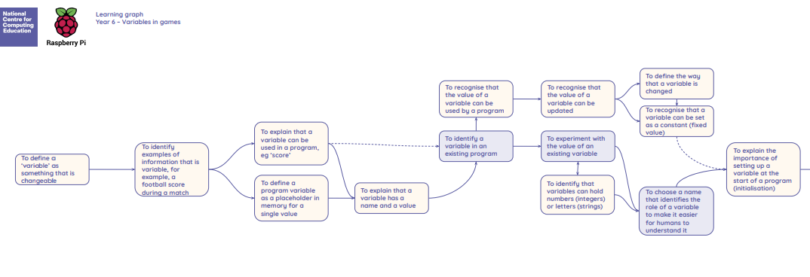

Slide 33
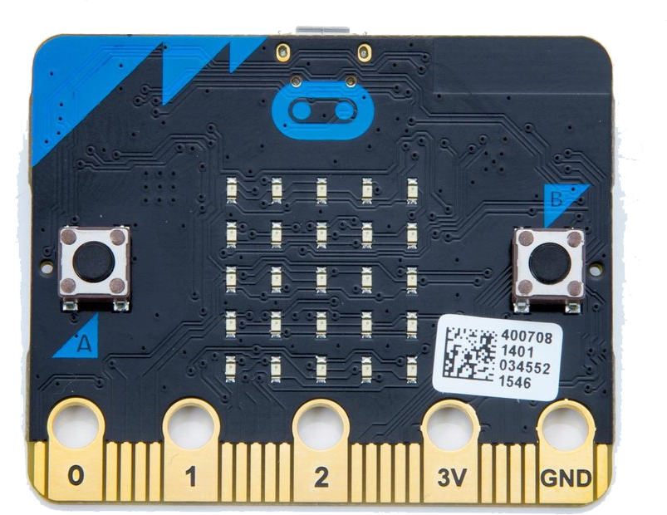
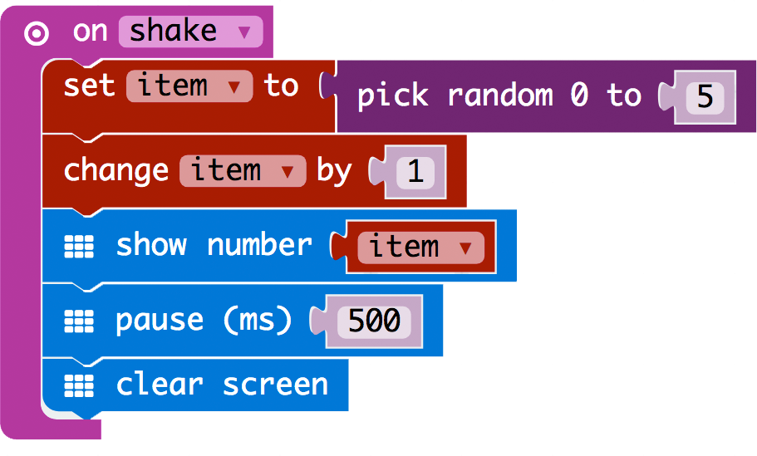
BBC micro:bit
Notes:
https://makecode.microbit.org/_9fhMiF7639cU

Slide 34
Incentives and drivers

Slide 35
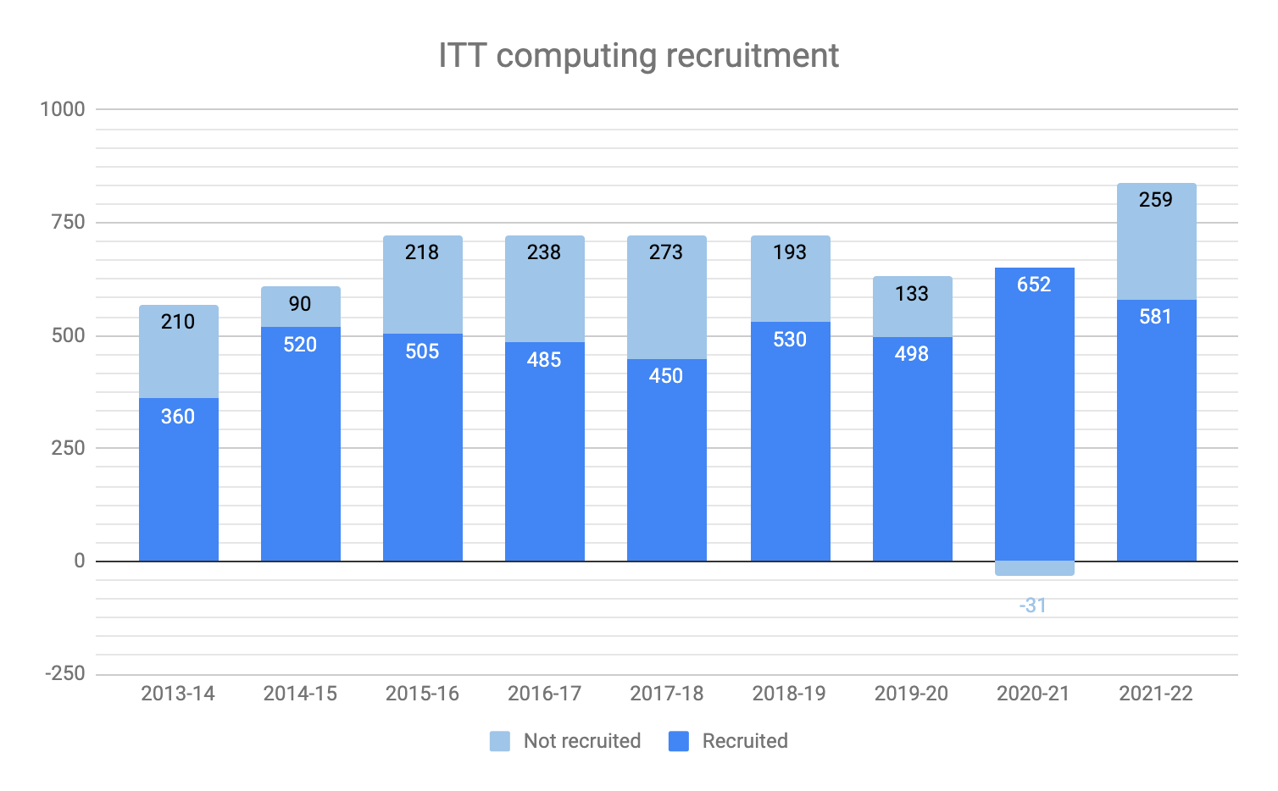
DfE, 2020

Slide 36
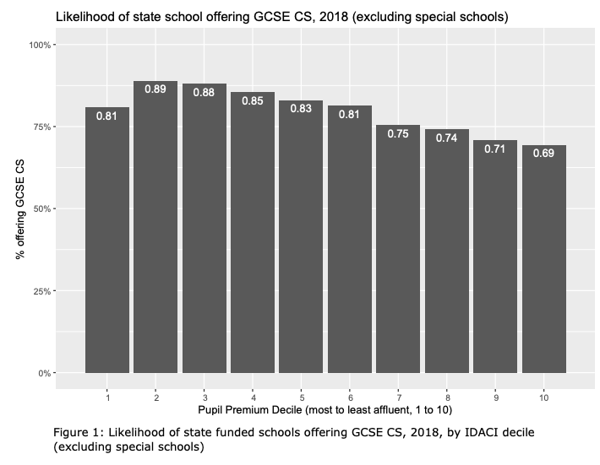
Kemp and Berry, 2019

Slide 38
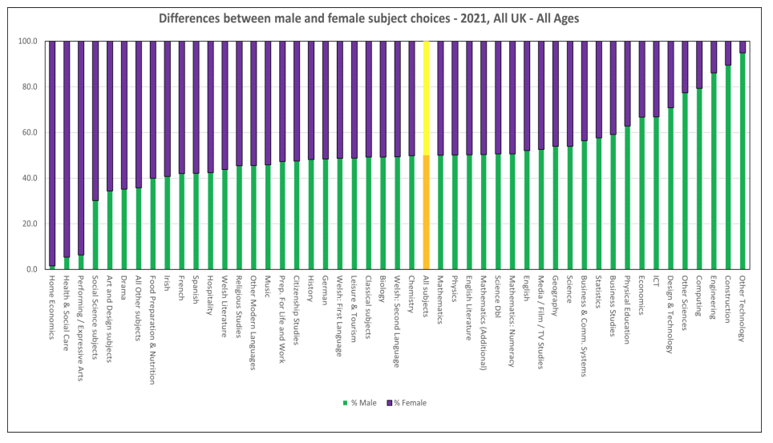

Slide 39
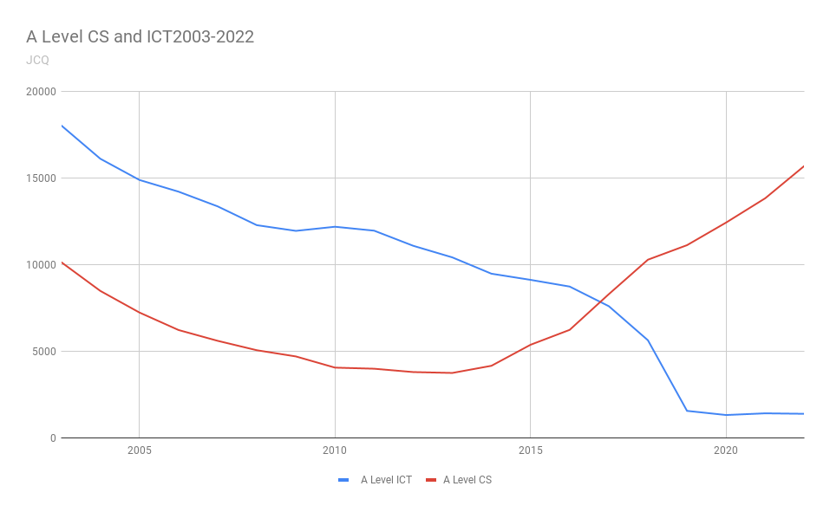

Slide 40
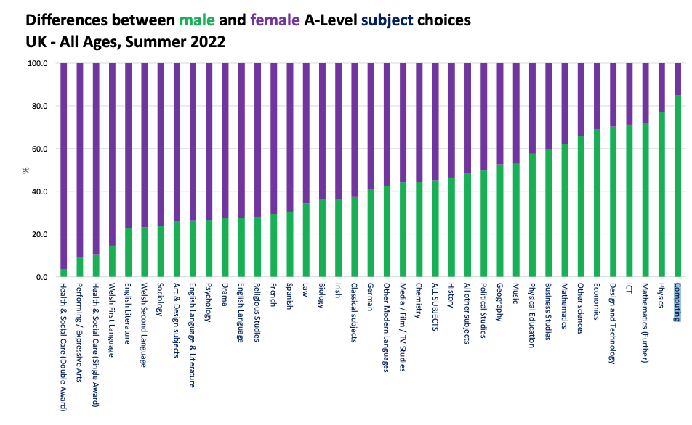

Slide 41
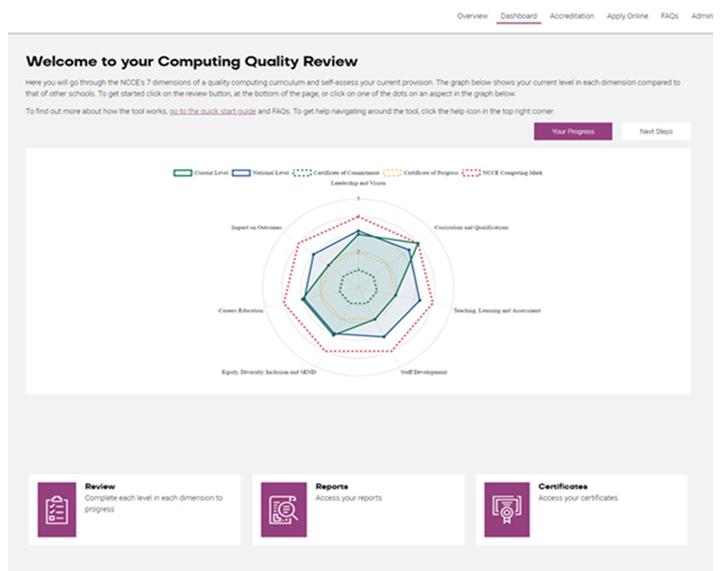
Support for school management
Computing Quality Framework now available to schools.
Over 880 schools now registered.
First 15 NCCE Computing Marks awarded.

Slide 42
Concluding remarks
Writing a curriculum framework isn’t enough
Plan for coherence
Training and resources are vital for success
Pedagogy?
Try to get the transition right
CS for all
Notes:
Writing a curriculum framework isn’t enough
Plan for coherence
Training and resources are vital for success
Pedagogy?
Try to get the transition right
CS for all

Slide 43
Questions?
m.berry@roehampton.ac.uk
@mberry
milesberry.net
these slides: bit.ly/wcce22

