Slide 1
...on Informatics curriculum in primary schools in Lithuania
Valentina Dagienė
Vilnius University

Slide 2
https://publications.jrc.ec.europa.eu/repository/handle/JRC128347

Slide 3
INTEGRATION of CT in Primary education
Legend
As a separate subject: BE FR, HR, CY, DK, IL, LT, PT, RU, RS, SG, SK, SI, CH, UK ENG
Within other subject(s): AT, HR, CY, DK, FI, FR, GE, HU, NO, PT, RO, RU, RS, Si, ES
As cross-curricular topic: AT, BE NL, CY, DK, FI, EL, LT, LU,
No data available

Slide 4
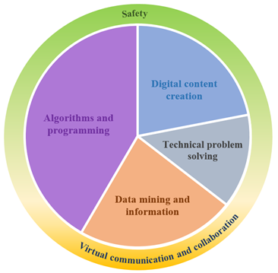
Informatics Education in Lithuania
Reformed Informatics curriculum in schools in Lithuania:
Integrated in grades 1-4
Mandatory in grades 5-10 (approx. 1 h per week)
Selected in grades 11-12
Six areas of Informatics achievements (aligned to DigComp 2.0)

Slide 5
Informatics Education in Lithuania
Algorithms & programming | Understand the benefits of an algorithm, a program, recognize and use informatics concepts Apply programming commands, logical operations and call programming interfaces (APIs) Create (code) and execute programs Detect bugs, test and improve programs. Use IDEs
Data mining & information | Understand the importance of data and information, make data analyses Perform various actions with data: collect, store, group, search, visualize Evaluate relevance and reliability of information
Digital content creation | Know various digital content for learning, recognize concepts Create various digital content: draw, write, compose, record, film, create mind maps, tables, diagrams Evaluate and improve, shares digital content

Slide 6
Informatics Education in Lithuania
Technical problem solving | Investigate hardware, see problems arising from the use of digital technologies, use properly technical concepts Select and combine various digital technologies Self-educate and self-evaluate own digital skills
Virtual communication & collaboration | Collaborate, share experiences and resources, communicate using digital technologies Assess the dangers of virtual communication, protects software and hardware
Safety | Protect health and environment Behave safely in virtual space

Slide 7
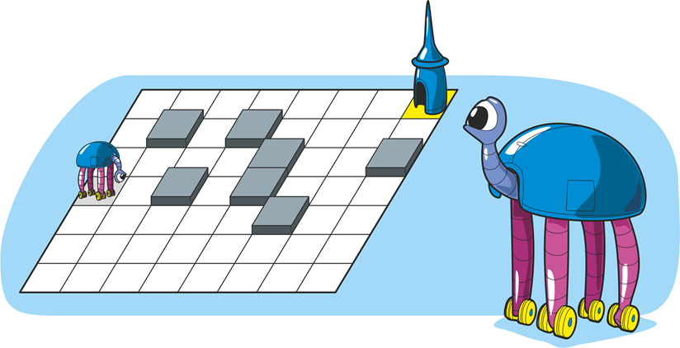
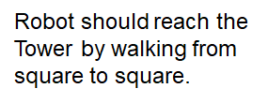
Informatics Education in Lithuania
Pilot “Informatics in primary schools”
(2017-2022)
1-4 grades
Integrated source
Official piloting in 100 schools (out of 400)
Many schools have implemented
The programmer has made a program out of movement direction commands marked by arrows:
V. Dagienė. THINK and CREATE

Slide 8
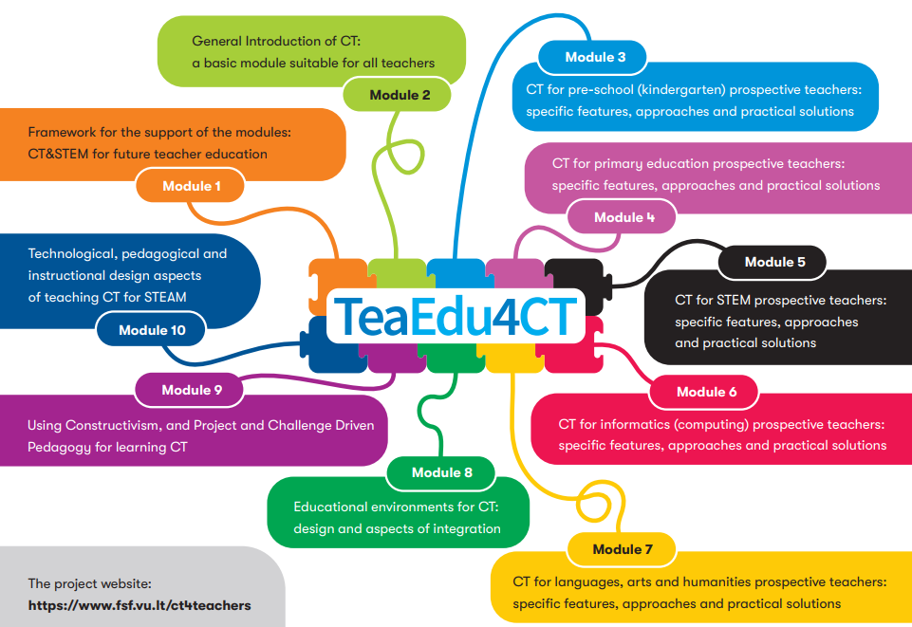
Teacher Education is important

