Slide 1
Educational Robotics: a lexical analysis of teachers’ resources
wcce2022.org
Christophe Reffay (UBFC), Gabriel Parriaux (HEP Vaud), Béatrice Drot-Delange (UCA)
Symposium: Informatics in Primary Education: … Lessons Learnt Ivan Kalas (chair), Torsten Brinda (co-chair), Peter Micheuz (co-chair)
World Conference on Computer Education, WCCE’22 Hiroshima, Japan, 20-24 August 2022
Notes:
Hello everybody, I’m Christophe Reffay and I come from University Bourgogne Franche-Comté in France. I have the pleasure and honour to present the work built in collaboration with 2 partners : Gabriel Parriaux from University of Teacher Education in Lausanne, Switzerland, and Béatrice Drot-Delange from Clermont Auvergne University in France. : Robotics in primary education: a lexical analysis on teachers’ resources across robots. This work is supported by the French National Research project IE-CARE.
Before starting the presentation, because some of you may escape during it… I want to thank :
organisers of this important international event and particularly Toshinori Saito who I met in Zanzibar for proposing Hiroshima to host WCCE22 and the Local Organisation Chair Prof. Dr. Masami Hagiya and their fabulous team, and the IPC co-chairs Rosa Bottino and Torsten Brinda, but also the support of TC3 Chair Don Passey.

Slide 2
"Robotics in Primary Education: a Lexical Analysis of Teachers' Resources Across Robots” Brief summary
Lexical analysis of teacher’s resources about robotic activities
Chi-square test and correspondence analysis: the words that teachers use in their productions are not the same according to the robot they use and to the level of teachers’ expertise
Experienced teachers use a richer CS vocabulary
Resources about
Thymio and Ozobot → more words related to machine and behaviour,
Beebot and Bluebot → more words related to sequential programming
Looking only at novices
Beebot → more words related to basic robot manipulation
Bluebot → more words related to sequential programming
Notes:
Give some examples of vocabulary (orally)
Thymio and Ozobot: wheels, sensors, line, color
Bluebot and Beebot: instruction, sequence,
Why is there such a distinction between Bluebot and Beebot (we thought that they were nearly the same robots…
Does it have something to do with the age of pupils? → Multiple correspondence analysis

Slide 3
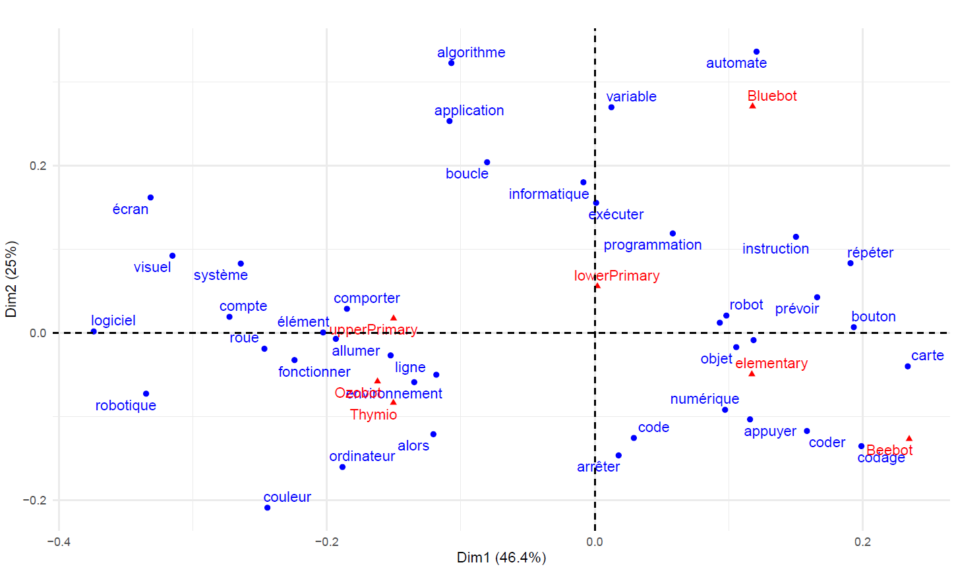
Multiple correspondence analysis CS lexicon across Pupil ages - Robots
Notes:
Classification of CS lexicon across robots and school levels

Slide 4
Lessons learnt for teacher education…
Robots have different affordances that let teachers work on different kind of notions according to the type of robot
Be more conscious and make more explicit those differences during teacher education to better show which robot is suitable in order to teach what notions

Slide 5
Lessons learnt for research…
Lexical analysis is an interesting approach to explore content of textual resources in the context of CS education
Combining quantitative and qualitative methods
Our work is exploratory with some limits:
heterogeneous corpus
“manual” selection of the CS vocabulary
Notes:
Based on the works of the French tradition of statistical analysis (Benzécri…)

Slide 6
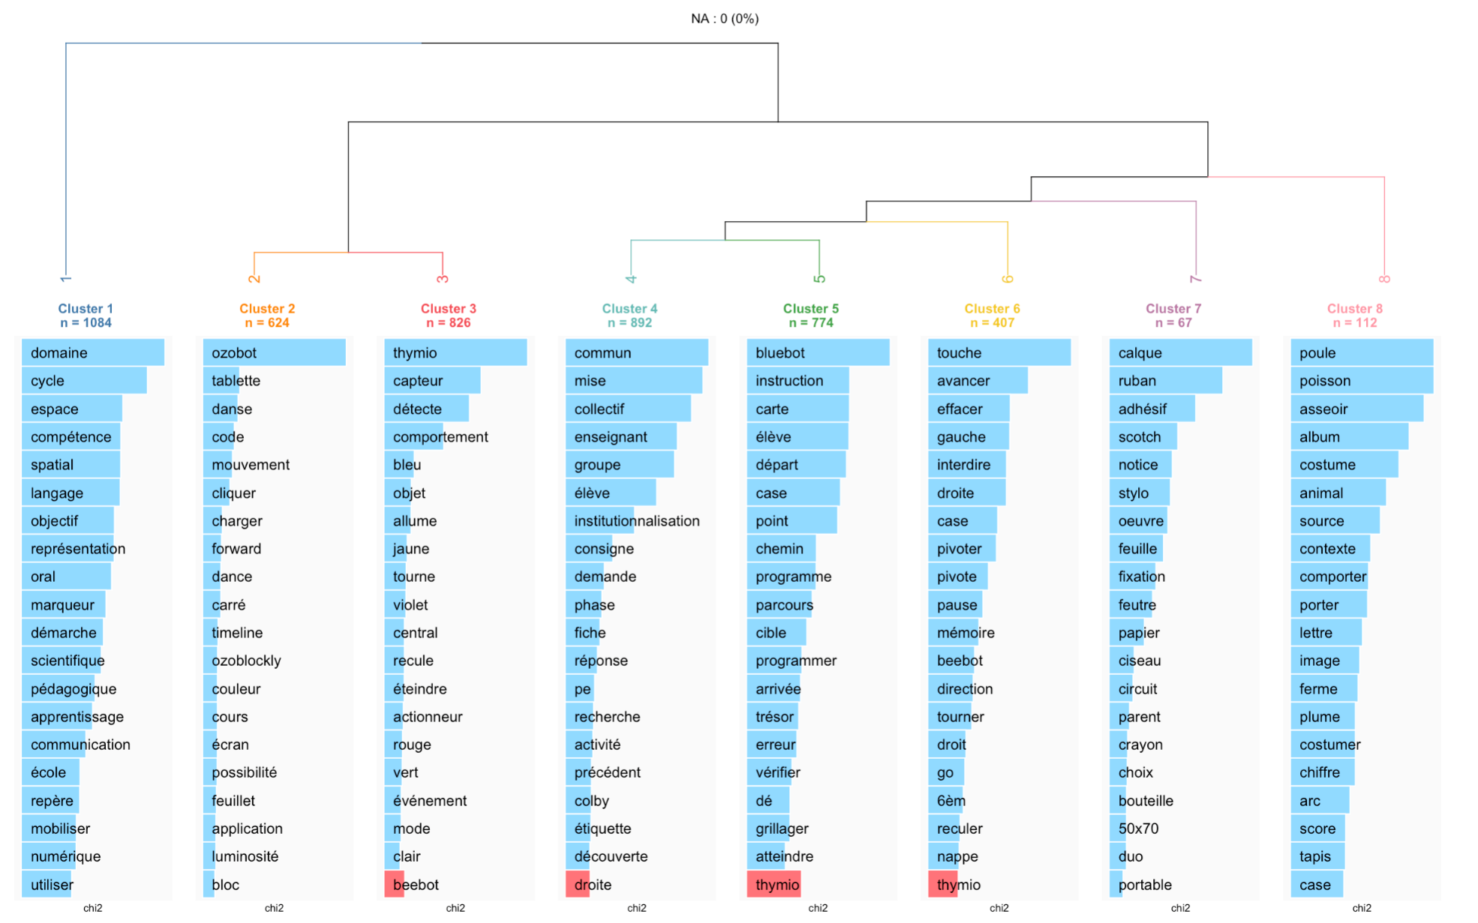
Further investigations
Use lexical analysis to explore interviews with teachers, classroom recordings
Apply text clustering method (Reinert’s hierarchical divisive clustering)
Inductive way of extracting topics of interest in a discourse

Slide 7
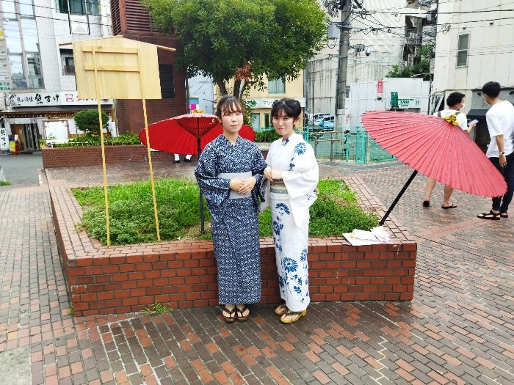
ご清聴ありがとうございました (Thank you for your attention)
Questions
Notes:
(Go seichō arigatō gozai mashita)

