Slide 1




Science+C: Preparing Science Teachers to Integrate Computing into Science Instruction
WCCE 2022
Hiroshima, Japan
August 21, 2022
Joyce Malyn-Smith, EDC
Irene A. Lee, MIT

Slide 2



EDC at a Glance
Education Development Center, Inc. (EDC), is a global nonprofit that advances lasting solutions to improve education, promote health, and expand economic opportunity. Since 1958, we have been a leader in designing, implementing, and evaluating powerful and innovative programs in more than 80 countries around the world.
Headquarters in
Waltham, Massachusetts
200+
projects managed annually by EDC.
1958
EDC was founded
by MIT scholars and researchers.
EDC has 1,300 employees.
Funders include USAID, NSF, NIH, MasterCard Foundation, DoEd, and SAMHSA
GLOBAL REACH
EDC has worked in more than
60 countries and in all 50 states
in the U.S.
REGIONS
» Africa
» Asia
» Europe
» Latin America and
the Caribbean
» Middle East
» United States
WCCE 2022 | Science+C: Preparing Science Teachers to Integrate Computing into Science Instruction

Slide 3

Vision of MA Department of Elementary and Secondary Education – Digital Literacy/CS Standards
The ability to effectively use and create technology to solve complex problems are the new and essential literacy skills of the twenty-first century.
WCCE 2022 | Science+C: Preparing Science Teachers to Integrate Computing into Science Instruction

Slide 4


Success in future scientific work requires foundational knowledge and skills in using the computational tools and processes (digital literacy) that enable creativity and innovation in these high tech work environments.

Slide 5
Science+C
National Science Foundation funded
Mirrors computational work practices of today’s scientists
Partnership with Massachusetts Department of Elementary and Secondary Education to implement MA Digital Literacy Computer Science Standards
Creates 3 new MA Science courses & course codes with modeling & simulation and Data Science+Machine Learning units inserted
Provides professional development to support implementation
WCCE 2022 | Science+C: Preparing Science Teachers to Integrate Computing into Science Instruction

Slide 6
WHAT IS SCIENCE+C?
Science+C
Designed to build foundational computer modeling skills/knowledge to help students learn to create, innovate and solve problems by using, decoding and modifying computational models
Broadens participation in STEM by reaching all students through integration of computer modeling into compulsory education courses
Introducing All Students to CS Within Core Science Courses (videohall.com)
WCCE 2022 | Science+C: Preparing Science Teachers to Integrate Computing into Science Instruction
6

Slide 7
BIG QUESTIONS:
Driven by Essential Questions
Can teachers and students learn to read and understand models without learning to write them? (by providing them with scaffolding and incremental builds)
Can teachers be given enough information about a specific model and how it works to be able to use it appropriately (in simulation experiments), teach decoding, and support student modification of models?
WCCE 2022 | Science+C: Preparing Science Teachers to Integrate Computing into Science Instruction

Slide 8
Contribution
Results from Research:
Results from research will directly inform how to:
Prepare students to use computational approaches to solve real-world problems in science and other fields, and
Improve or enhance student understanding of science and other fields through explorations made possible by computational approaches.
WCCE 2022 | Science+C: Preparing Science Teachers to Integrate Computing into Science Instruction

Slide 9
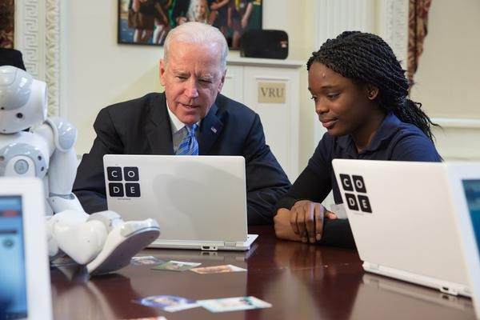
Why Integrate CS Across the Curriculum?
To engage K-12 students in CS/CT
To address CS and Disciplinary standards
To bypass difficulties of offering stand-alone CS classes
Because there has been a shift in what STEM professionals do
To reflect the importance of developing and using models in STEM
WCCE 2022 | Science+C: Preparing Science Teachers to Integrate Computing into Science Instruction

Slide 10
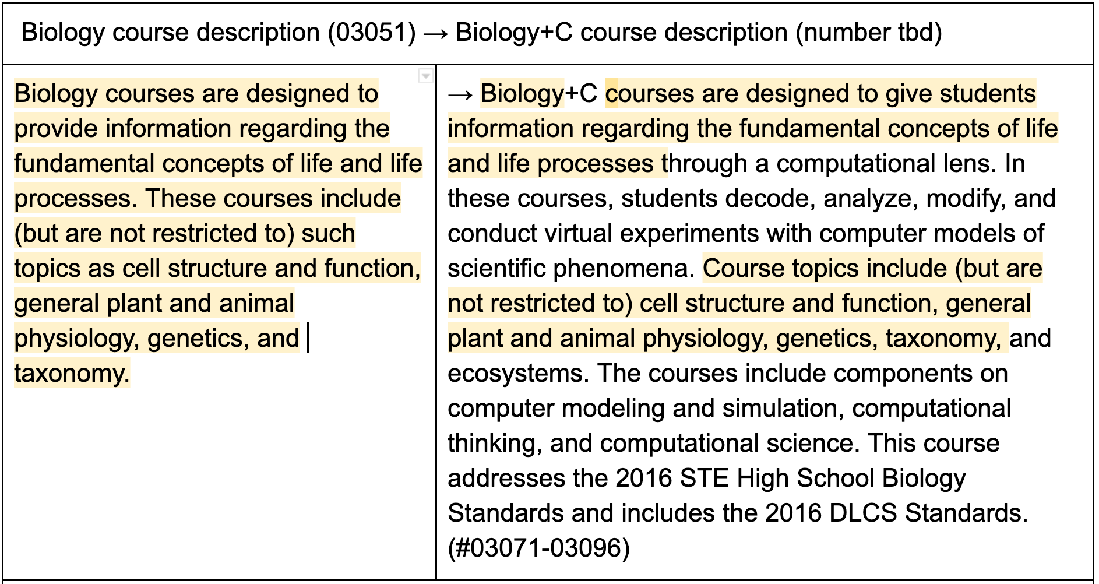
Developing the Science+C Course Descriptions
Biology+C
WCCE 2022 | Science+C: Preparing Science Teachers to Integrate Computing into Science Instruction

Slide 11



WHAT DOES SCIENCE+C INCLUDE?
Introductory Unit 0: Epidemic Modeling
Science+C units are designed to be integrated into biology, chemistry, and physics courses.
Biology + C
Simple Ecosystems
Natural Selection
Enzymes
Photosynthesis
Homeostasis
Genetics
Ecosystems
Dynamics
Chemistry + C
Matter
Nuclear Physics
Bonding
Kinetics
Titration
REDOX
Physics + C
Kinematics I
Kinematics II
Simple Harmonic Motion
Mechanical Waves
Nuclear
Physics
Electricity:
Series Circuits
WCCE 2022 | Science+C: Preparing Science Teachers to Integrate Computing into Science Instruction
11

Slide 12

Why has Integrating CS been Hard?
Steep learning curve for programming
No time to teach CS and programming within core subjects
Teaching programming not part of STEM teacher’s role
Teachers comfortable with canned simulations limiting what students can do and learn (can’t look under the hood)
WCCE 2022 | Science+C: Preparing Science Teachers to Integrate Computing into Science Instruction
12

Slide 13
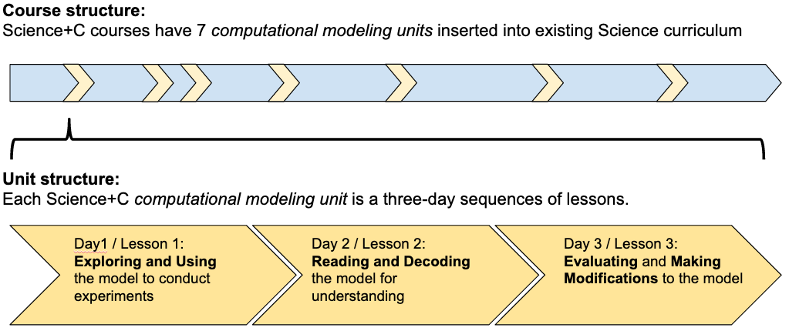
SCIENCE+C COURSE & UNIT STRUCTURE
Science+C Curriculum Progression
Year-long course
Science+C Unit
Lesson 1: Use
Lesson 2: Decode
Lesson 3: Modify
Explore the model to determine what phenomena it is trying to represent and use the model to run experiments.
Read and interpret the code to understand how the model works and how the code relates to the science principles.
Use the knowledge gained from using and decoding the model to modify the model and run new experiments.
WCCE 2022 | Science+C: Preparing Science Teachers to Integrate Computing into Science Instruction
13

Slide 14
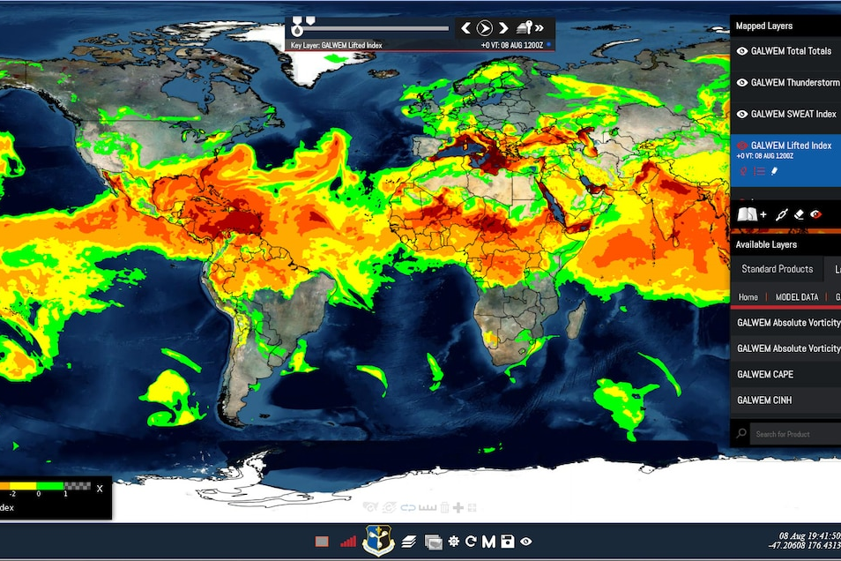
Why Use Models?
Models and modelling are important tools for problem solving, prediction, decision making, and communication and have been studied and analysed in the history, philosophy, and sociology of science and technology, and in the engineering sciences.
Hallström, J., Schönborn, K.J. Models and modelling for authentic STEM education: reinforcing the argument. IJ STEM Ed 6, 22 (2019). https://doi.org/10.1186/s40594-019-0178-z
WCCE 2022 | Science+C: Preparing Science Teachers to Integrate Computing into Science Instruction
14

Slide 15

Continuum of Integrating Models in STEM Classes
Science+C
Units
USE
DECODE
MODIFY
CREATE
SIMULATION
ONLY
DECODING
APPROACH
PROGRAMMING
APPROACH
NOT CT
CT
WCCE 2022 | Science+C: Preparing Science Teachers to Integrate Computing into Science Instruction
15

Slide 16
Use the Model to Conduct Experiments
Setup the model and notice all inputs and outputs.
Choose ONE input to change.
Choose ONE output to observe.
Run several experiments.
  Change the displacement
  Click “Setup”
  Click “Go/Pause” to start
  Record the value/observation
  Click “Go/Pause” to stop
Input Initial Displacement | Output
WCCE 2022 | Science+C: Preparing Science Teachers to Integrate Computing into Science Instruction
16

Slide 17
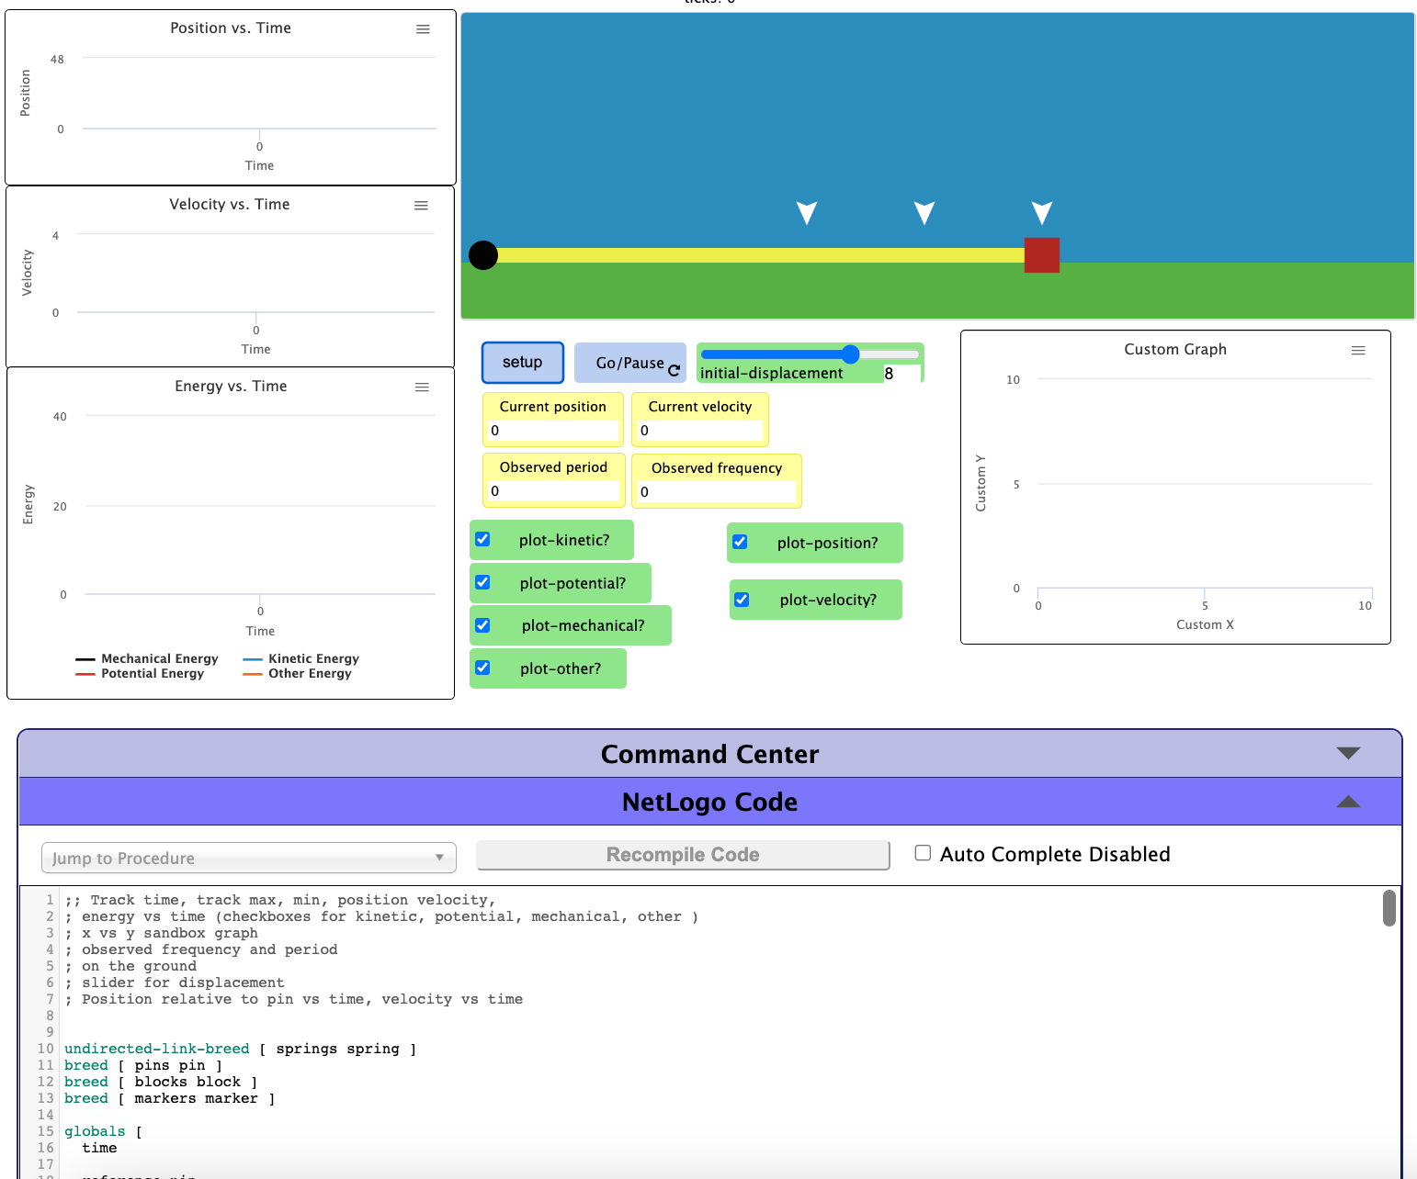
Decoding the Model
Models contain more code than students “need” to read
Goal is to understand the model, not recreate it from scratch
Focus on procedures:
  that contain science concepts
  explain how model works
  can be modified to improve the model
WCCE 2022 | Science+C: Preparing Science Teachers to Integrate Computing into Science Instruction

Slide 18
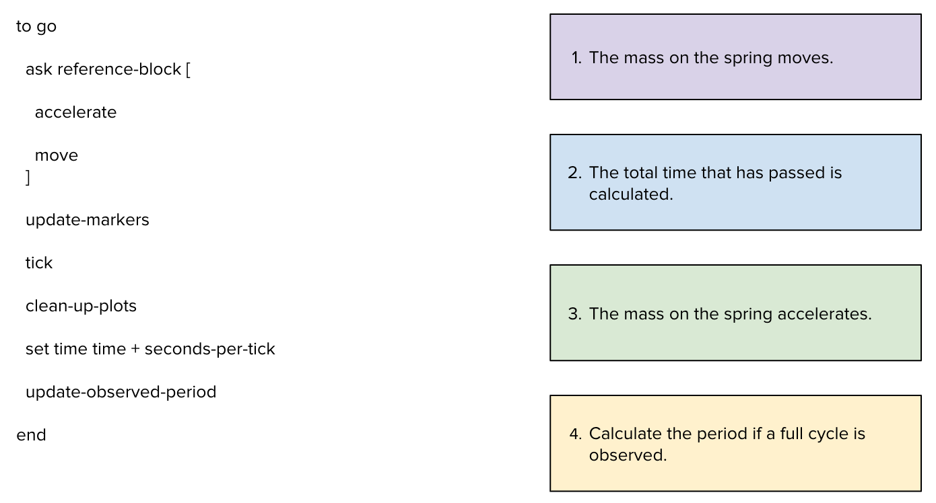
Practice Decoding the Model
Match code segments to explanations of the code
Prepare an explanation for what your procedure does and how
Identify what physics concepts are found in the code
WCCE 2022 | Science+C: Preparing Science Teachers to Integrate Computing into Science Instruction

Slide 19
MODIFYIL
Modifying the Model
Focus of Lesson 3 is on modifying the model AND experimenting with modified model.
Lesson 2 Exit Ticket:
  What’s wrong or missing in the model? How would you modify the model to make it more accurate or to answer another question?
WCCE 2022 | Science+C: Preparing Science Teachers to Integrate Computing into Science Instruction
19

Slide 20
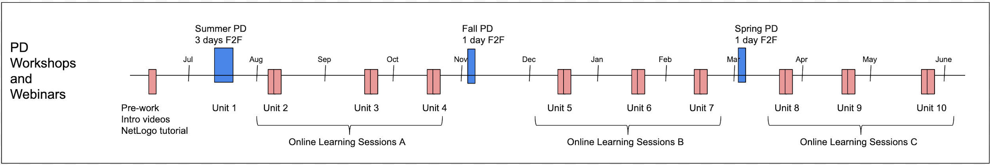
Professional Development Continuum
SCIENCE+C PD Description of elements
PRE-SUMMER (prior to summer pd) Getting started; Setting up your accounts; Intro videos + 2 hour self-guided NetLogo tutorial
Summer PD (mid-July) 3 Days of f2f (including Unit 0 and Unit 1)
Day 1: Orientation (to project and team) and demos; Day 2: Intro to NetLogo and Intro to Unit 1; Day 3: lesson study practice
Online Learning Sessions A: Unit 2 : (Early Aug) / Unit 3: (late Sept) / Unit 4: (late Oct)
Fall PD (Beginning of Nov) 1 Day f2f; Skill building, Pedagogy. Lesson study / practice teaching; share successes and challenges – learn from each other.
Online Learning Sessions B: Unit 5: (Dec) / Unit 6: (Jan) / Unit 7: (Feb)
Spring PD (Beginning of March) 1 Day f2f; Skill building; Pedagogy; Break into groups by field– successes and challenges – learn from each other ; Lesson study practice teaching
Online Learning Sessions C: Unit 8: (April) / Unit 9: (May) / Unit 10: (June)
WCCE 2022 | Science+C: Preparing Science Teachers to Integrate Computing into Science Instruction
20

Slide 21
Stipends & Certificates of Completion for PDPs
Stipends
                PD Stipends: $1,700.
            Research Incentives: ($450 - all tasks must be completed in order for student data to be usable)
Certificates of Completion for Professional Development Points
Total PD Hours: 68
                PD hours will be prorated based on attendance
                Certificates emailed by end of June
WCCE 2022 | Science+C: Preparing Science Teachers to Integrate Computing into Science Instruction
21

Slide 22
Worksholements
Key Elements of PD
WCCE 2022 | Science+C: Preparing Science Teachers to Integrate Computing into Science Instruction
22

Slide 23
Worksholements
Other Workshop Gains
WCCE 2022 | Science+C: Preparing Science Teachers to Integrate Computing into Science Instruction
23

Slide 24
Worksholements
Student Responses
WCCE 2022 | Science+C: Preparing Science Teachers to Integrate Computing into Science Instruction
24

Slide 25
Worksholements
Other Pre-Post Gains
WCCE 2022 | Science+C: Preparing Science Teachers to Integrate Computing into Science Instruction
25

Slide 26
Strengths of Professional Development
Teacher Reported Curriculum Strengths
Science+C is aligned with standards helping them meet DLCS goals that the district wants them to address
NetLogo is accessible to people whose devices do not allow software installation. NetLogo is on the web, anyone can use it to experiment with models
Unit 0 introduced NetLogo concepts using everyday knowledge of pandemics and provided a structure repeated in all units
Repetitive structure of the curriculum (career connections, …facilitated an incremental growth/skills/knowledge – “I don’t need to wear the student hat anymore, I can move on to learning how to teach the lesson…”
WCCE 2022 | Science+C: Preparing Science Teachers to Integrate Computing into Science Instruction
26

Slide 27
Feedback from Teachers
Teacher Reported PD Strengths
Access to facilitators - 1 to 1 access - just in time support
Facilitators are teachers who have implemented Science+C in their own classrooms
Peer support from CoP – in-person meetings; online
Administrative support - schools are recognized by DESE for introducing digital learning and CS courses (recognition)
PD is well paced – Initial 3 day training includes Unit 0 and 1 unit taught within each specialization; Monthly meetings prepare teachers to teach upcoming units; teachers share implementation stories – what’s working, not working
WCCE 2022 | Science+C: Preparing Science Teachers to Integrate Computing into Science Instruction
27

Slide 28
Wrap-Up Dis-cussion
Science+C – Preliminary Findings In Review
Science+C’s Use-Decode-Modify approach, providing scaffolding and incremental builds, is helping non-CS teachers and students learn to read and understand models without learning to write them.
Given enough information about a model and how it works, non-CS teachers are learning to use it appropriately (in simulation experiments), teach decoding, and support student modification of models.
WCCE 2022 | Science+C: Preparing Science Teachers to Integrate Computing into Science Instruction
28

Slide 29

Wrap-Up Discussion
Take Aways?
What’s one idea that you are taking away from today’s session?
What’s one thing that you are wondering about or want to learn more about?
Are you interested in learning more about Science+C? If so contact Joyce Malyn-Smith at jmsmith@edc.org
WCCE 2022 | Science+C: Preparing Science Teachers to Integrate Computing into Science Instruction
29

Slide 30


Joyce Malyn-Smith, EDC
jmsmith@edc.org
Irene A. Lee, MIT
ialee@MIT.edu

