Slide 1
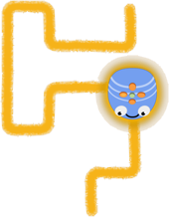
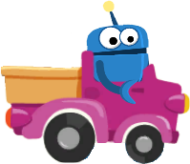
Levels of Control
in Primary Robotics
Ivan Kalas, Andrea Hrušecká
Comenius University, Bratislava
a part of the Symposium: Informatics in Primary Education:
Approaches, Current Issues and Lessons Learnt

Slide 2
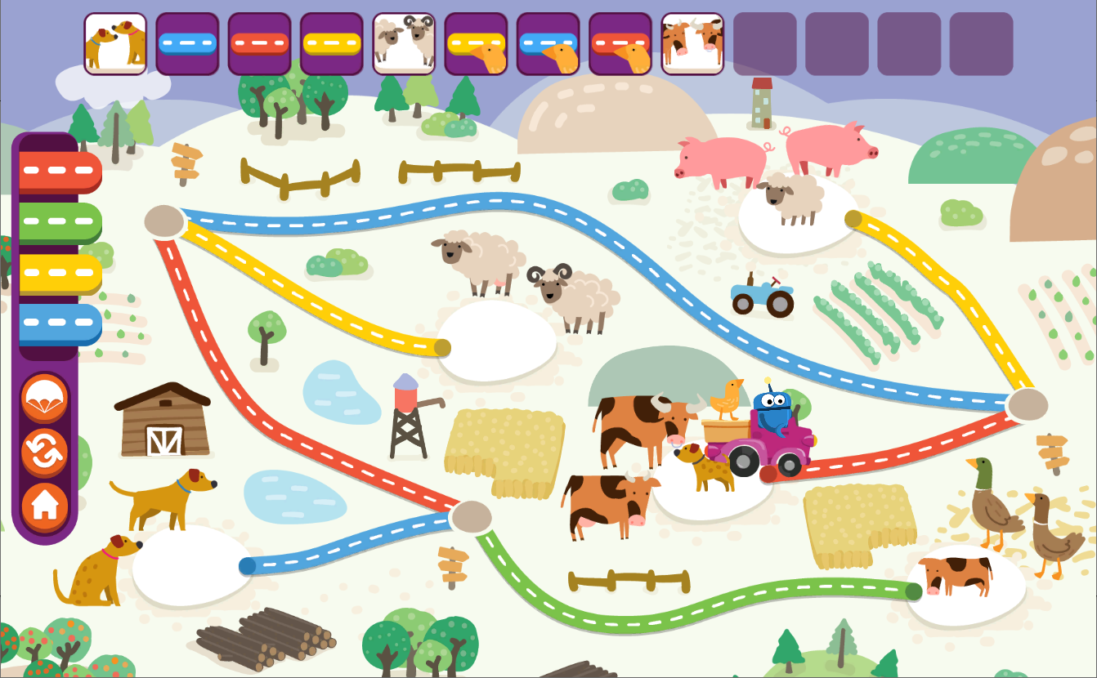
Informatics in Primary Levels of Control in Primary Robotics
introduction
Since 2017 we have been developing educational content for
Informatics as a subject in primary (Years 1 to 4, ages 6 to 10)
under the overall name Computing with Emil --- as Informatics for All

Slide 3
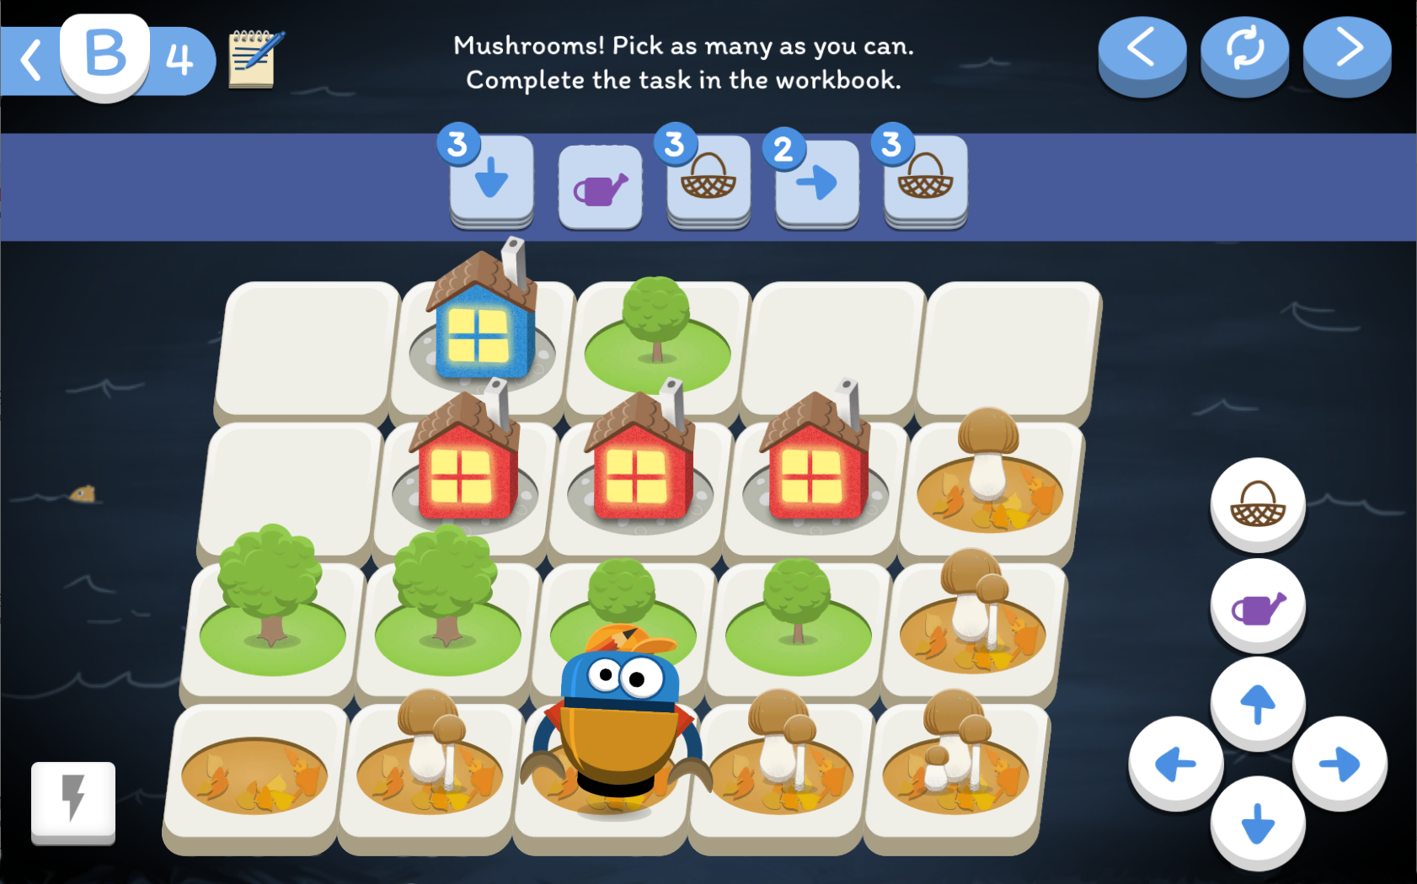
Informatics in Primary Levels of Control in Primary Robotics
introduction
Since 2017 we have been developing educational content for
Informatics as a subject in primary (Years 1 to 4, ages 6 to 10)
under the overall name Computing with Emil --- as Informatics for All

Slide 4
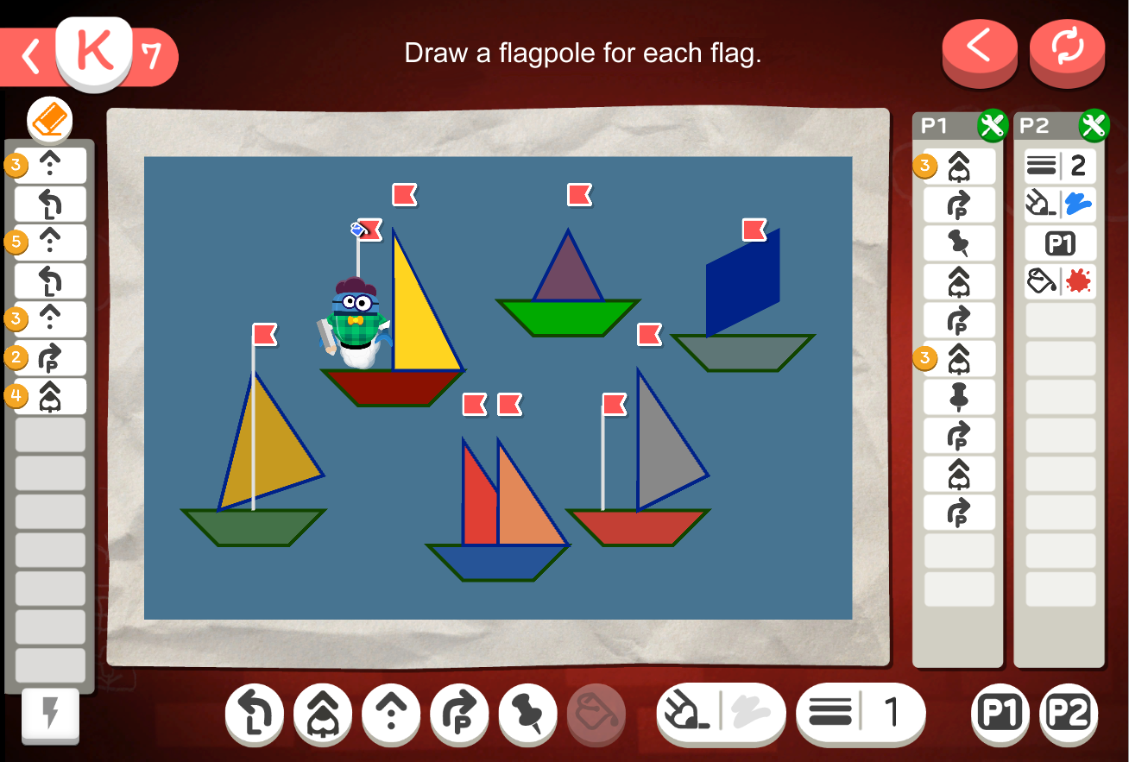
Informatics in Primary Levels of Control in Primary Robotics
introduction
Since 2017 we have been developing educational content for
Informatics as a subject in primary (Years 1 to 4, ages 6 to 10)
under the overall name Computing with Emil --- as Informatics for All

Slide 5
Informatics in Primary Levels of Control in Primary Robotics
introduction
Since 2017 we have been developing educational content for
Informatics as a subject in primary (Years 1 to 4, ages 6 to 10)
under the overall name Computing with Emil --- as Informatics for All
why? --- because we believe that
content should continue and progress from one Year to another
with carefully planned and verified learning goals
we consider programming a key component of CT
but must respect developmental appropriateness
what is programming? …way of exploring, thinking, expressing…
content must be such that general primary teachers
understand it and want to do it
consider it useful and proper for their pupils
! AND also - we are developing a set of research instruments suitable for investigating the cognitive processes of pupils in the early stages of their computational thinking (CT)

Slide 6
Informatics in Primary Levels of Control in Primary Robotics
context and our earlier findings (1/3)
our latest component of the Emil project – Robotics for Primary --- follows the same motivations and in this work we want to contribute to Q3:
Lessons learnt
What have you already learnt in the process, what are the methods or designs you have applied, what are the findings within this context?
one of the interesting research areas we have explored earlier in this context
… the forms and levels of control of a virtual and a tangible character
in primary infomatics (in our case, Emil on the screen, and Blue-Bots on the floor)
in accord with Blackwell (2002) we believe that pupils…
program things whenever they stop directly manipulate observable things but specify behaviour to occur at some future time
Blackwell continues by pointing out two reasons why programming is hard:
loss of the benefits of direct manipulation, and
introduction of notational elements to represent abstraction

Slide 7
Informatics in Primary Levels of Control in Primary Robotics
context and our earlier findings (2/3)
in our previous research on forms of control in Computing with Emil for Year 3 [2] we identified four levels of increasing cognitive demand, namely
(i) direct manipulation,
(ii) indirect manipulation,
(iii) direct control, and
(iv) computational control, i.e., programming
as a second dimension to control, we also identified five levels of
how the process itself is represented:
(1) no representation, or be an
(2) internal record
(3) external record
(4) internal plan, or
(5) external plan
i.e. a program using certain notation, as common in programming

Slide 8
Informatics in Primary Levels of Control in Primary Robotics
context and our earlier findings (3/3)

Slide 9
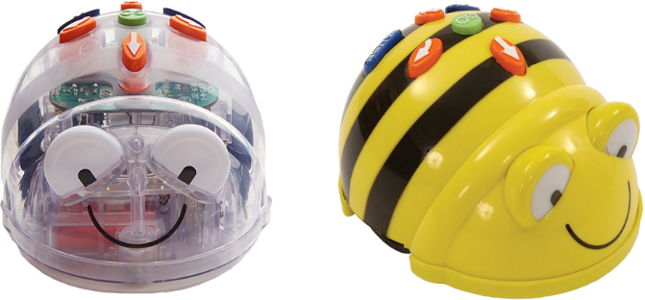
Informatics in Primary Levels of Control in Primary Robotics
educational robotics (1/4)
we are strongly convinced that educational robotics – with its typical teamwork on the floor style – MUST be a part of any informatics content in primary Years
we are using TTS Blue-Bot programmable
floor robot (we call her Ema)
with the blue plastic panels
for programming
pupils wirelessly connect panels to their robots
use small plastic command cards to control them
work in teams of 4 (in some schools of 3 or 2, but never alone)
and discuss in teams and all class regularly

Slide 10
Informatics in Primary Levels of Control in Primary Robotics
educational robotics (2/4)
our priority is to make the most of the potential of programable toys
to support deeper understanding of some basic Informatics concepts
based on exciting and motivational tangible experience
we draw on two assumptions of Seymour Papert:
programming provides exceptional opportunities to explore
powerful ideas … of computing and CT
in education programming we gradually transfer the focus of the pupils from solving a problem to
an explicit representation of the solution procedure – program
i.e. the program (either a record or a plan of steps) becomes
an object to think with and think about
… and discuss, share, explain, modify …

Slide 11
Informatics in Primary Levels of Control in Primary Robotics
educational robotics: two examples of activities (3/4)

Slide 12
Informatics in Primary Levels of Control in Primary Robotics
educational robotics: two examples of activities (3/4)

Slide 13
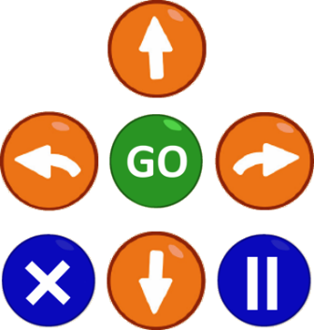
Informatics in Primary Levels of Control in Primary Robotics
educational robotics (4/4)
in the robotics thread of our content for primary we have 20 lessons
5 lessons for Year 1 (or later)
5 lessons for Year 2 (or later)
5 lessons for Year 3 (or later)
5 lessons for Year 4
in Year 1 --- using blue panels, from one command to program
in Year 2 --- using buttons on the robot, program hidden inside
in Year 3 --- using paper cards + buttons, program explicit
in Year 4 --- whichever form
teams find better
in our current research within robotics thread of Emil
we try to validate the two-dimensional structure of control/representation
we explore cognitive demand of different forms of control
in the progression of the content, in particular…

Slide 14
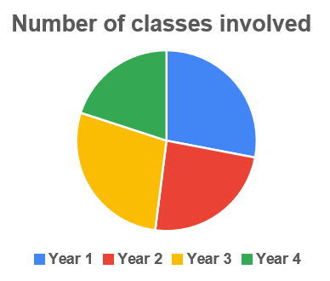
Informatics in Primary Levels of Control in Primary Robotics
method, sample, data and findings
we contacted 70+ teachers in Slovakia and Czech Republic who participated in our robotics 1 day PD sessions
38 reacted to our first set of questions
7 of them then answered in detail
the second set of questions
representing 25 classes of Years 1 – 4
in the second set we were interested in:
how pupils accept our robotics and its pedagogy
how they react to working in teams, using Blue-Bots and blue panels
pupils' attitude to using the workbooks… and more
we applied standard qualitative research methods and analysis
How do pupils accept the use of the blue panels?
How do they perceive the transition from direct control to multi commands planning?
if educational robotics starts with the use of the blue panel,
the transition from direct control to computational control can become trivial
… sometimes even a pupil who did not do well before, will perform so well!

Slide 15
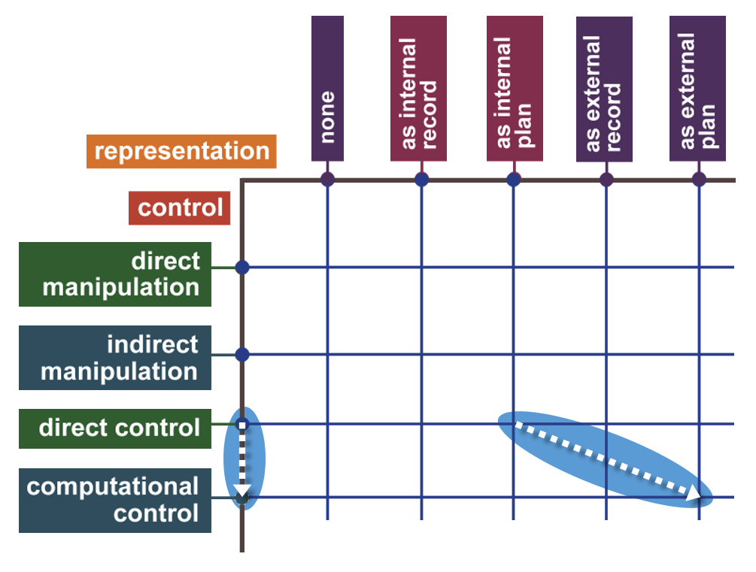
Informatics in Primary Levels of Control in Primary Robotics
method, sample, data and findings
we contacted 70+ teachers in Slovakia and Czech Republic who participated in our robotics 1 day PD sessions
38 reacted to our first set of questions
7 of them then answered in detail
the second set of questions
representing 25 classes of Years 1 – 4
in the second set we were interested in:
how pupils accept our robotics and its pedagogy
how they react to working in teams, using Blue-Bots and blue panels
pupils' attitude to using the workbooks… and more
we applied standard qualitative research methods and analysis
How do pupils accept the use of the blue panels?
How do they perceive the transition from direct control to multi commands planning?
if educational robotics starts with the use of the blue panel,
the transition from direct control to computational control can become trivial
… sometimes even a pupil who did not do well before, will perform so well!

Slide 16
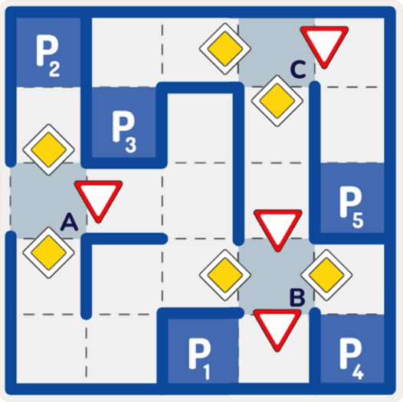
Thank you for your attention
Contact
ivan.kalas@fmph.uniba.sk
References
Blackwell, A (2002).: What is Programming? In: 14th Workshop of the Psychology of Programming Interest Group, pp. 204-218
Kalas, I., Horvathova, K. (2022): Programming Concepts in Lower Primary Years and Their Cognitive Demands. Springer, vol 642, https://doi.org/10.1007/978-3-030-97986-7_3
Kalas, I. et al. (2018): Exploring Control in Early Computing Education. In: Pozdniakov, S., Dagienė, V. Informatics in Schools. Fundamentals of CS and Software Engineering. ISSEP 2018. LNCS, vol 11169. Springer, Cham, pp. 3-16
Kalas, I. et al. (2022): Programming in Year 4: An Analysis of the Design Research Process. Proc of CSEDU, Vol 2, pp. 425-433

